Slide 1

Apache Flink Introduction
Ethan Lin
ML8 CIM System Div
2017.02.24
Ethan_Lin@wistron.com

Slide 2
Agenda
Streaming
Streaming Processor Comparison
Flink Introduction
Flink Streaming Architecture
Flink Operation
Accurate computation
Exactly-Once Streaming Fault-Tolerance
Debugging & Monitoring

Slide 3
Streaming

Slide 4
Streaming
Streaming
以連續的方式到達並川流不息的序列資料
移動中車輛所發出的GPS信號
證交所的金融交易
網絡流量與機台日誌
感測器的感測數據
通常與時間位移有關
Why Streaming
需立刻獲得結果
資料具備實效性
較貼近於我們生活方式
Streaming is the biggest change in data infrastructure (Flink Forward 2015)
Streaming is a rapidly growing and maturing market category of its own (Flink Forward 2016)
Notes:
水杯喝水 水管喝水
So there is an appeal to processing data as streams, but that’s been
difficult to do well, and the challenges of doing so are even greater
now as people have begun to work with data at very large scale
across a wide variety of sectors. It’s a matter of physics that with
large-scale distributed systems, exact consistency and certain knowledge
of the order of events are necessarily limited. But as our methods
and technologies evolve, we can strive to make these limitations
innocuous in so far as they affect our business and operational goals.

Slide 5
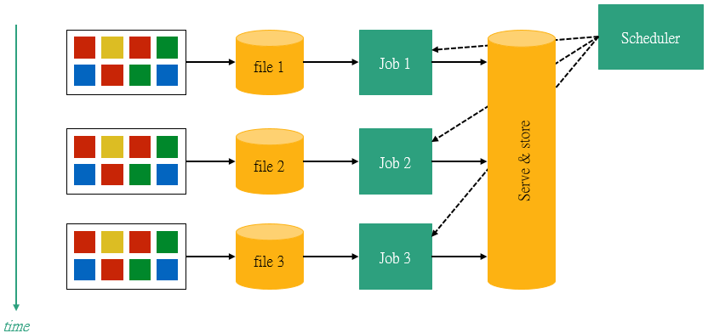
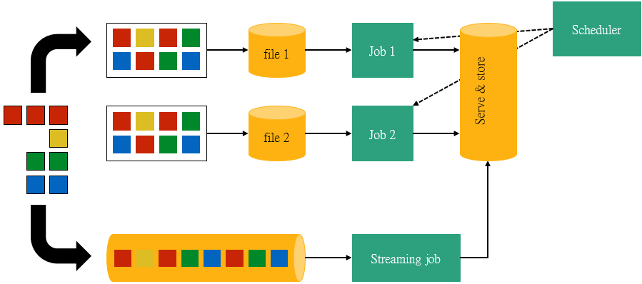
Streaming computation
Streaming運算

Slide 6

Streaming computation
Streaming運算
偵測異常的交易
判斷奇怪的感測器資料
過濾感興趣的資料

Slide 7
Streaming Processor Comparison

Slide 8
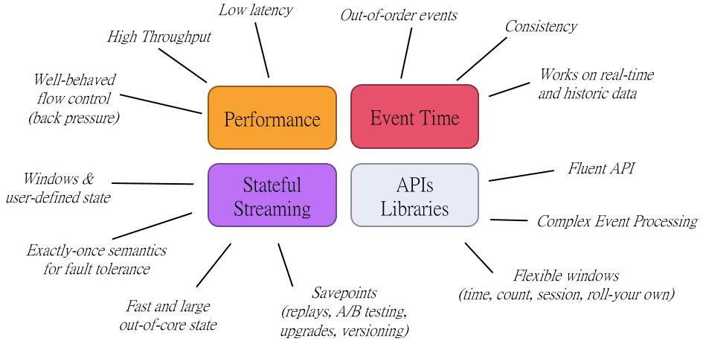
Streaming Processor (1/2)
其實，Streaming相當不簡單

Slide 9
Streaming Processor (2/2)
Streaming運算引擎發展
Apache Storm
True streaming / At-least-once / Not build in state management / Low latency / Low throughput /
Low level API (Bolts, Spouts) + Trident
Spark Streaming
On top of batch system / Exactly-once / Dedicated DStream for state management / Medium latency / high throughput
Functional API (DStreams), restricted by batch runtime
Apache Flink
True streaming / Exactly-once / Stateful operators / Low latency / high throughput
Rich functional API exploiting streaming runtime; e.g. rich windowing semantics
Slightly different stream notion, low level API
True streaming built on top of Apache Kafka / At-least-once / Stateful operators / Low latency / high throughput
Apache Samza

Slide 10
Flink Introduction

Slide 11

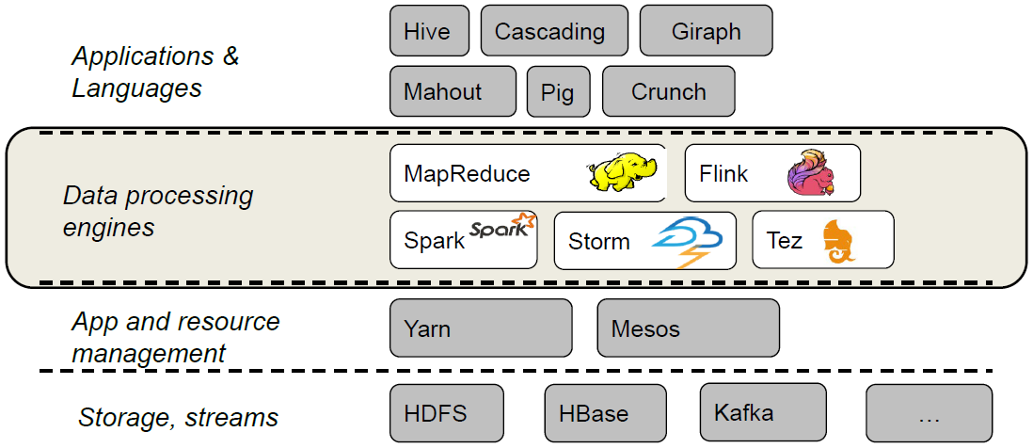
Apache Flink是一款基於開源協議發行的分佈式運算框架，其核心是ㄧ個以Java及Scala實現的分佈式串流計算引擎
在德文中"Flink"具有快速、靈活之意
Notes:
在2015年的一月份成為Apache頂級專案

Slide 12
Flink Features
分散式架構
優異的性能
低延遲
高吞吐量
運算
同時支援串流計算與批量計算
更彈性的windowing概念
Event time運算
精確
具狀態性與容錯機制
迭代和增量迭代
隨時可取用

Slide 13
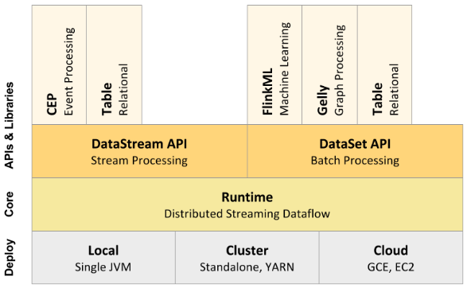
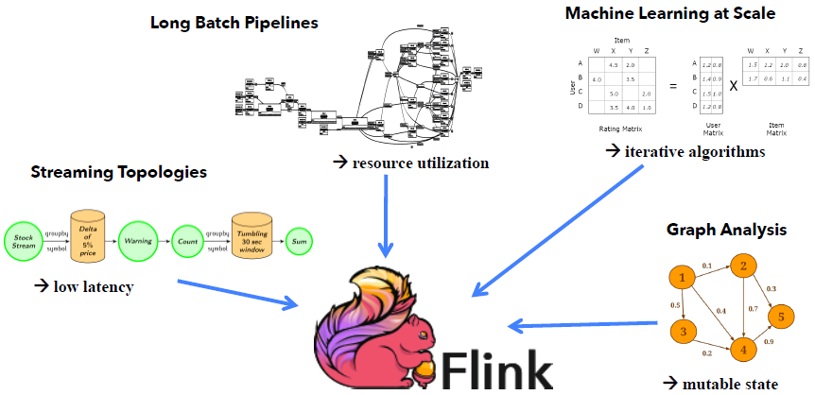
Flink Components Stack
Flink模組及模組應用

Slide 14
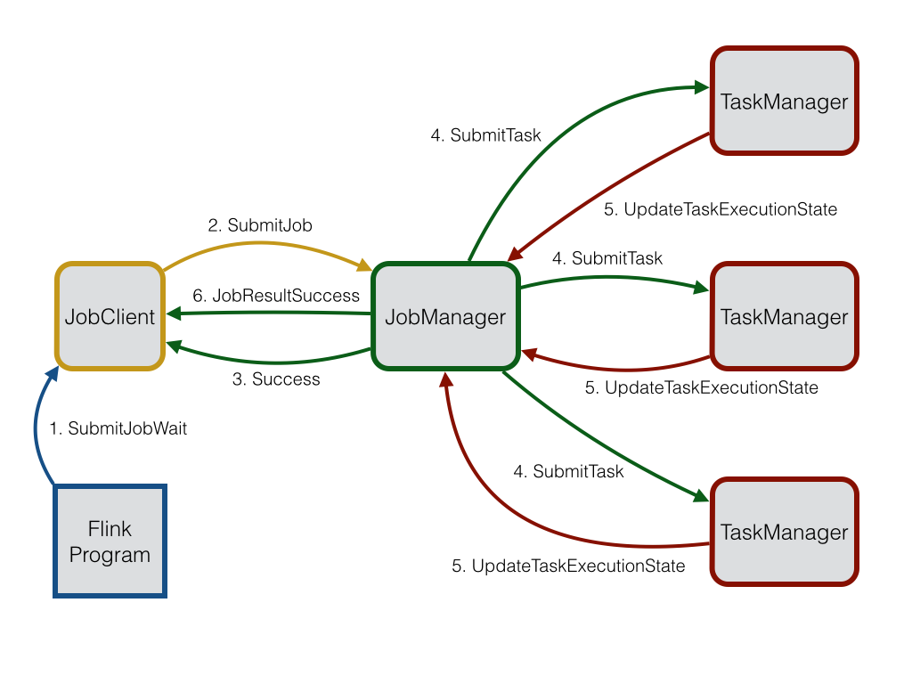
Lifetime of a Flink Job
Flink Job的作業調度

Slide 15
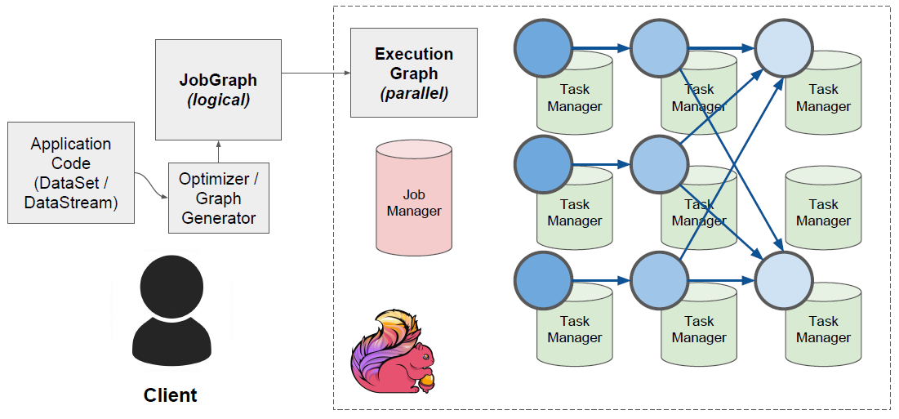
Lifetime of a Flink Job
Flink Job的作業調度

Slide 16












Who is Using Flink?

Slide 17
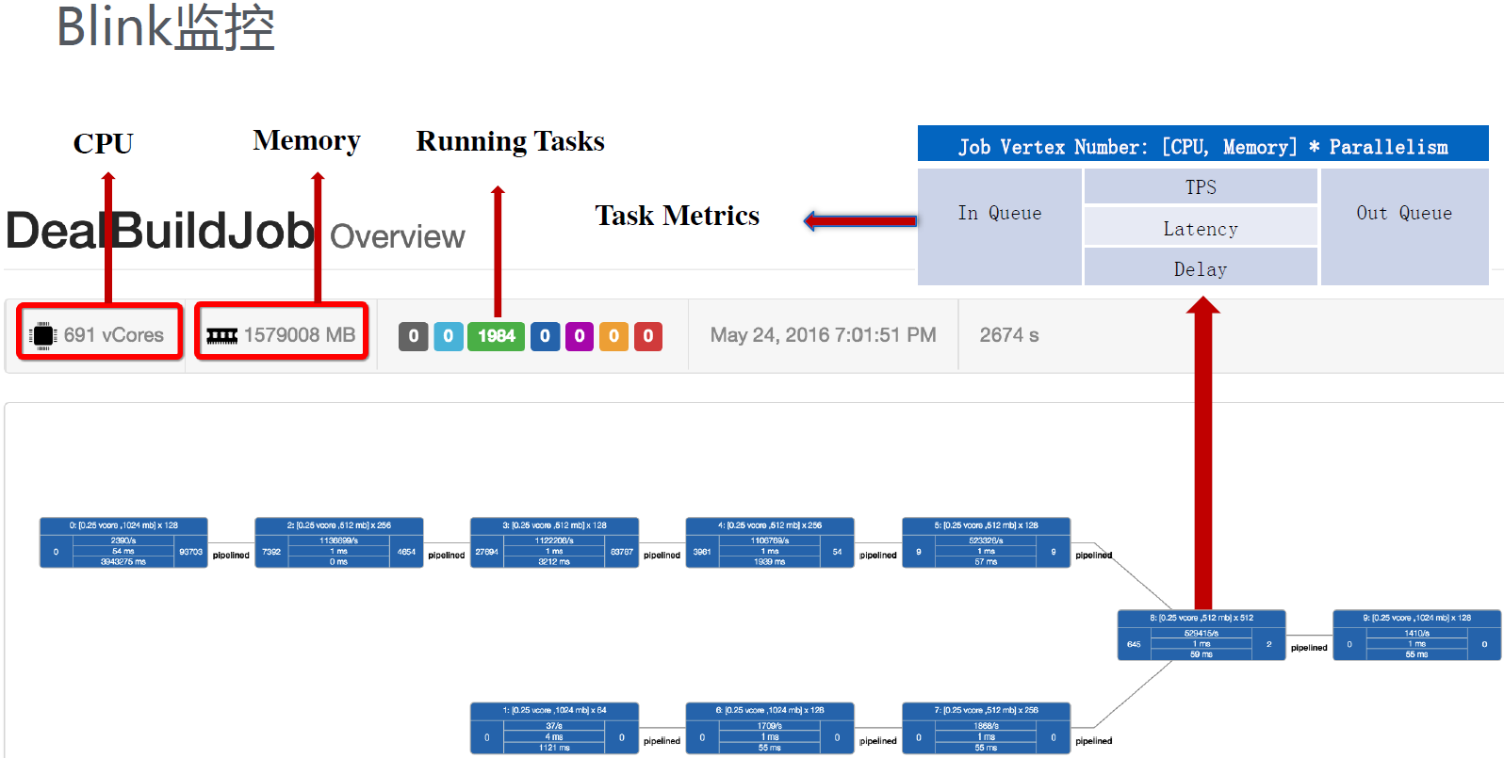
Flink Using in Alibaba
阿里巴巴在1000台(多於5000個vCores)叢集節點之上運行Flink，提供每秒數以百萬計的事件運算能力
阿里巴巴最大的一個運算任務配置了超過20組operators來支援其服務
以Flink為基礎自行開發Blink

Slide 18
Streaming Architecture in Flink

Slide 19
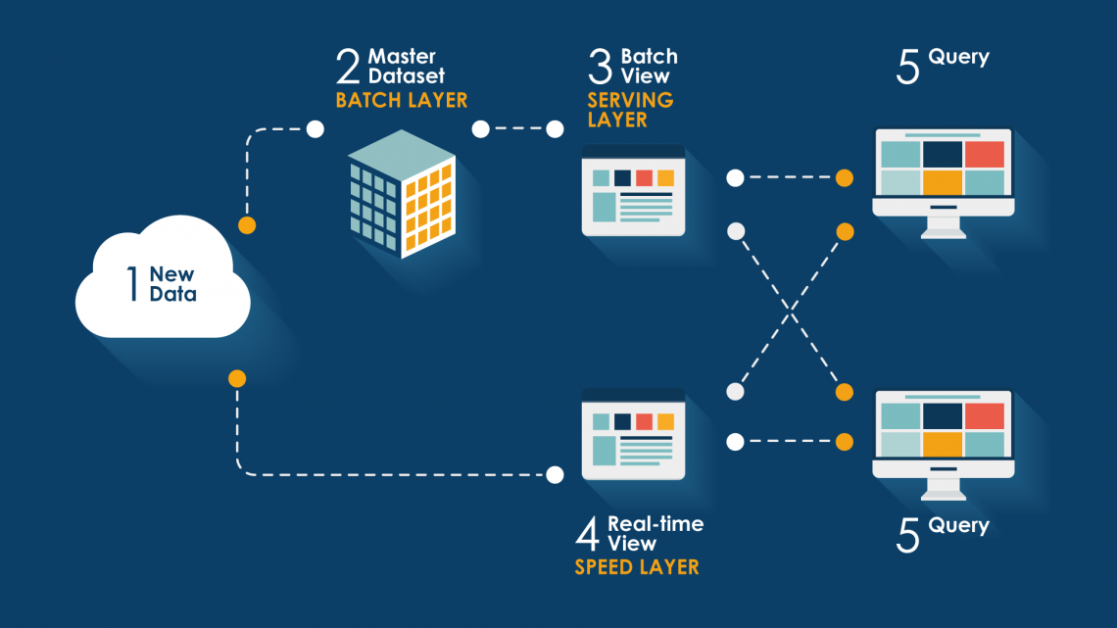
Lambda Architecture
資料處理新架構 - Lambda

Slide 20
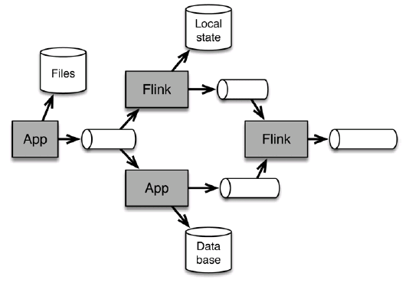
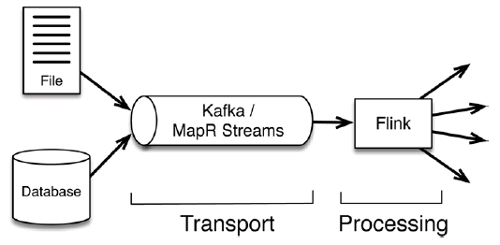
Streaming-First Architecture
在Flink串流運算的典型架構
Notes:
Kappa Architecture
More real-time reaction to events
Robust continuous applications
-Continuous batch apps are duck-taped together from many tools
Process both real-time and historical data
-Using exactly the same application

Slide 21
Flink Operation

Slide 22
Flink Operation
Flink Operation
Accurate computation
Windows
Event-time streaming
Watermarks
Exactly-Once Streaming Fault-Tolerance
Stateful streaming
Consistency in Flink
Debugging & Monitoring
Savepoints
Back Pressure

Slide 23
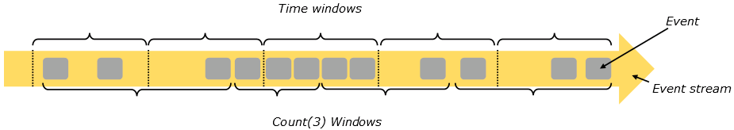
Windows (1/4)
Window
根據時間或某些特徵來分組及收集一系列事件
以此方式對這些事件進行整體分析或操作
驅動方式
時間驅動(Time Windows) : 每30秒驅動一次
資料驅動(Count Windows)每3個元素驅動一次
窗口模式
Tumbling(不重複)
sliding(重複)
session(間隔一段不活動的間隙)

Slide 24
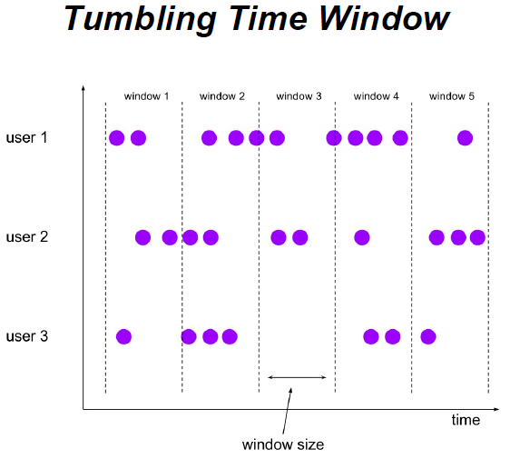
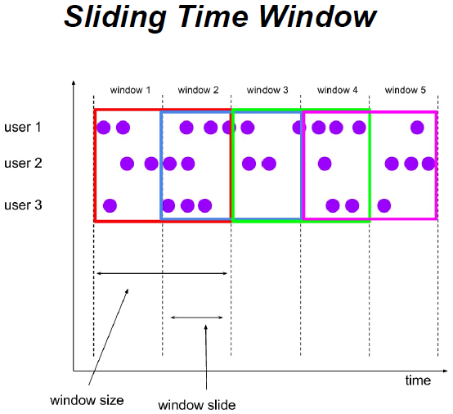
Windows (2/4)
Time Windows
最簡單也最常被使用
可以是tumbling或sliding

Slide 25
Windows (3/4)
Count Window
使用事件個數驅動而非時間
可以是tumbling或sliding
範例
每100個顧客計算一次平均消費
近10片主機板的良率狀況

Slide 26
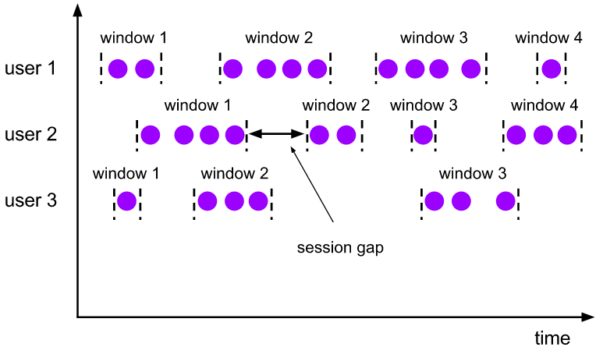
Windows (4/4)
Session Windows
Session是一段有相同特徵或相依性事件的活動區段
目前開源串流運算引擎中僅有Flink支援Session運算
需設定timeout時間 (定義我們想要等待多長時間，讓我們清楚Session已經結束)
範例
登入期間使用者共點幾了幾個連結

Slide 27
Event-time streaming
三種"時間"的類型
Processing Time
系統處理事件當下的時間
Wall Time
Ingestion Time
系統收到事件的時間
Wall Time
Event Time
事件被產生時的時間
保留在資料本體

Slide 28
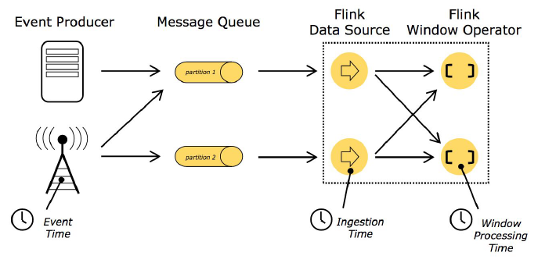
Event-time streaming (1/2)
三種"時間"的類型

Slide 29
Event-time streaming (2/2)
Flink的框架能自動處理Event Time運算
在大部分情況，我們不該用Wall Time
嘗試統計廣告連結每小時"被點擊"的次數
我們關心的是事件本身 (廣告被點擊)的數量與時間，而非系統所收到的事件數量
使用Event Time才能處理亂序事件
使用Kafka中的資料重新進行運算 (new model / bug fix / auditing purposes)
如果用Wall Time將會是一場災難
Notes:
temporary lack of connectivity, varying delays of the network, clocks in distributed systems, data
rate spikes, physics, or just bad luck

Slide 30
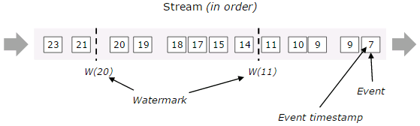
Watermarks
Watermarks
一種機制讓Flink能夠知道event time的時間進展
根據資料流中每筆資料event time的流動判斷
Watermarks攜帶一個時間戳t，當一個Flink task收到t watermark，此任務task就可以知道不會再收到早於t 的事件了
Flink 1.1.0後可設定allowedLateness

Slide 31
Flink Operation
Flink Operation
Accurate computation
Windows
Event-time streaming
Watermarks
Exactly-Once Streaming Fault-Tolerance
Stateful streaming
Consistency in Flink
Debugging & Monitoring
Savepoints
Back Pressure

Slide 32
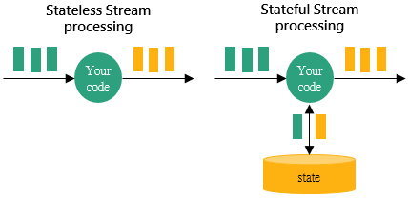
Stateful Streaming (1/2)
如果要從串流中洞察出資訊通常不能僅觀察一筆資料
任何類型的聚合都是有狀態的
所有種類的Windows
CEP (Complex Event Processing)
串流之間的join
相對於Batch，Streaming的stateful運算是一件不容易的事情

Slide 33
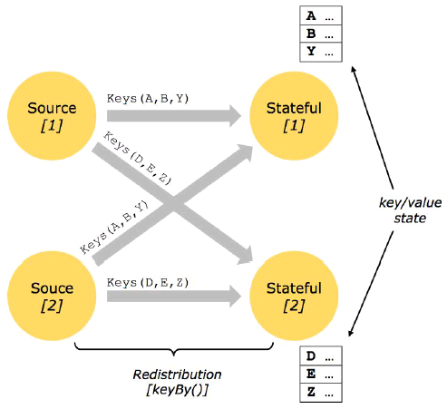
Stateful Streaming (2/2)
Key-Partitioned State
以Key/Value結構儲存
需先透過key將串流進行分組(KeyBy)才可以使用
開發人員可決定何時儲存、何時讀取

Slide 34
Consistency in Flink (1/5)
Flink不僅能保存狀態並且被設計為在各種故障情形下保證state的存在及正確性
一致性等級(發生故障後資料可復原的程度及正確性)
At most once
資料可能會在故障後丟失
At least once
不丟失資料，但可能會在故障後產生重覆資料
Apache Storm, Apache Samza
Exactly once
故障後依然保持一致
Apache Spark, Apache Flink

Slide 35
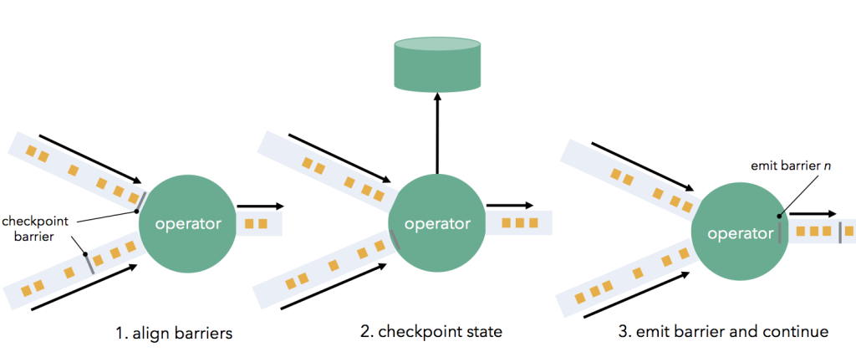
Consistency in Flink (2/5)
Flink Checkpoints
Flink確保Exactly Once的方法
根據Asynchronous Barrier Snapshotting algorithm
由Flink自動產生(JobManager產生)並控制checkpointing時機
開發人員可自行定義什麼是state (需要保存什麼)
Kafka consume offset
累計的資料

Slide 36
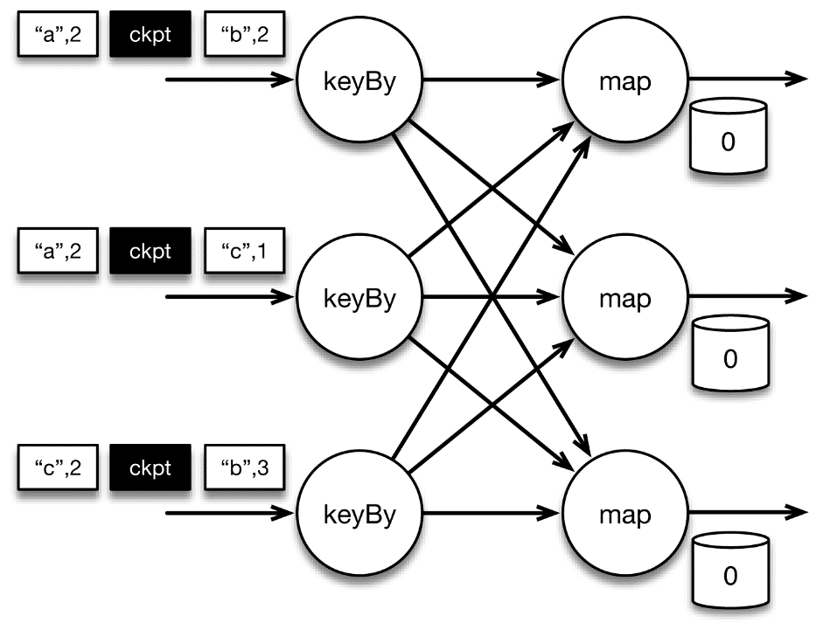
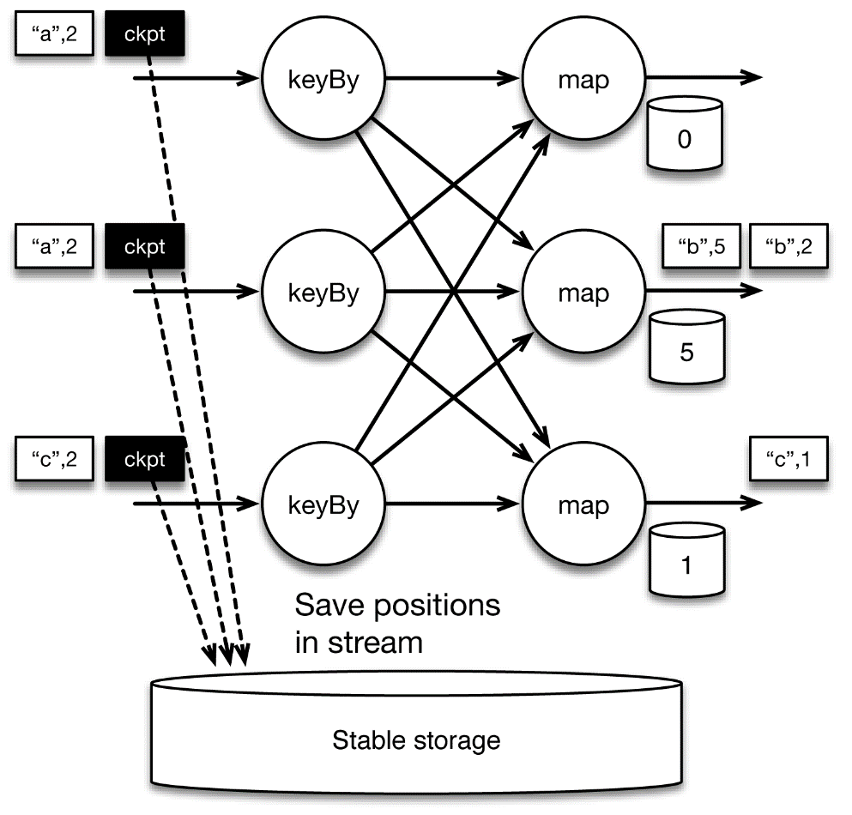
Consistency in Flink (3/5)
Checkpointing Step

Slide 37
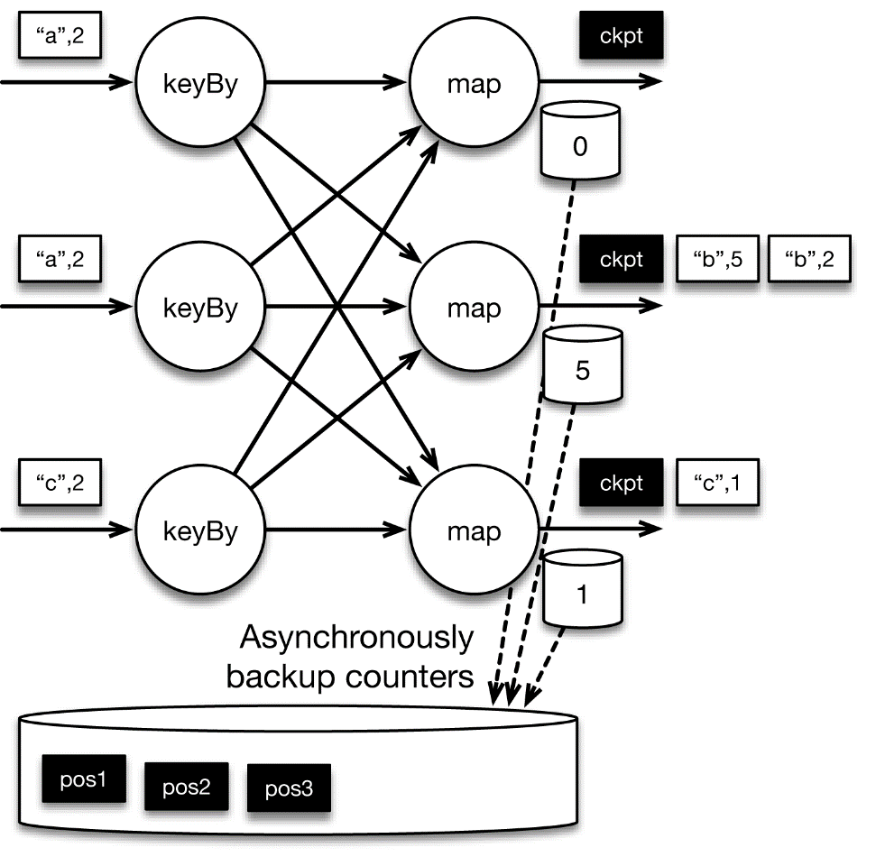
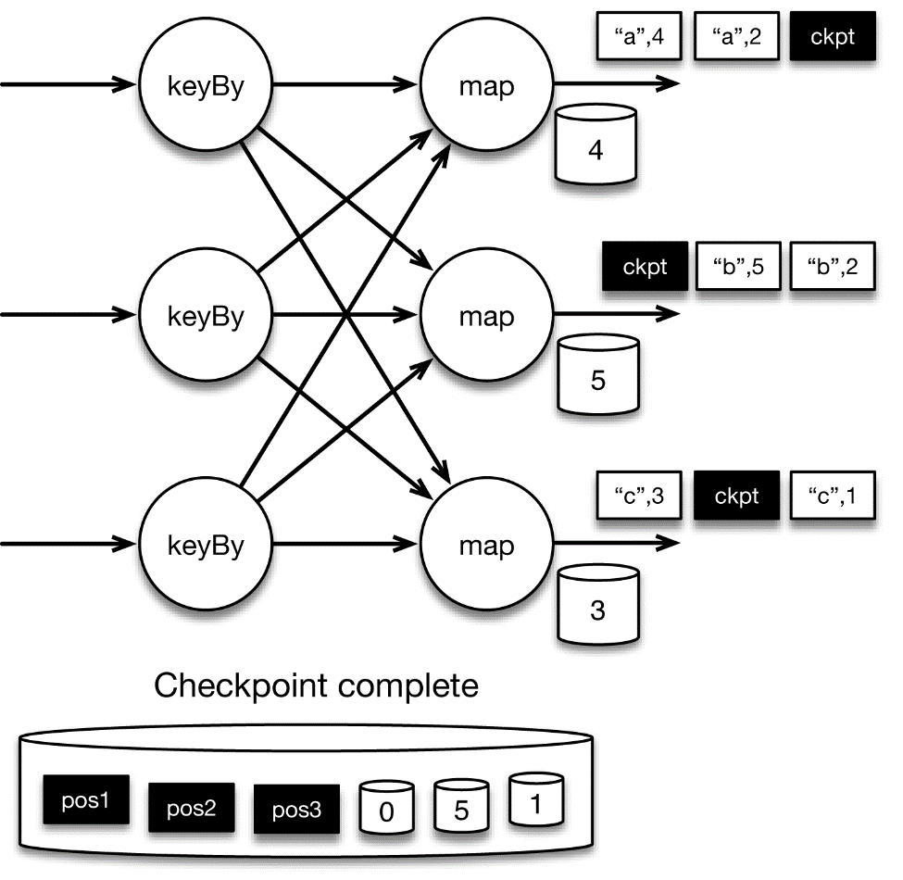
Consistency in Flink (4/5)
Checkpointing Step

Slide 38
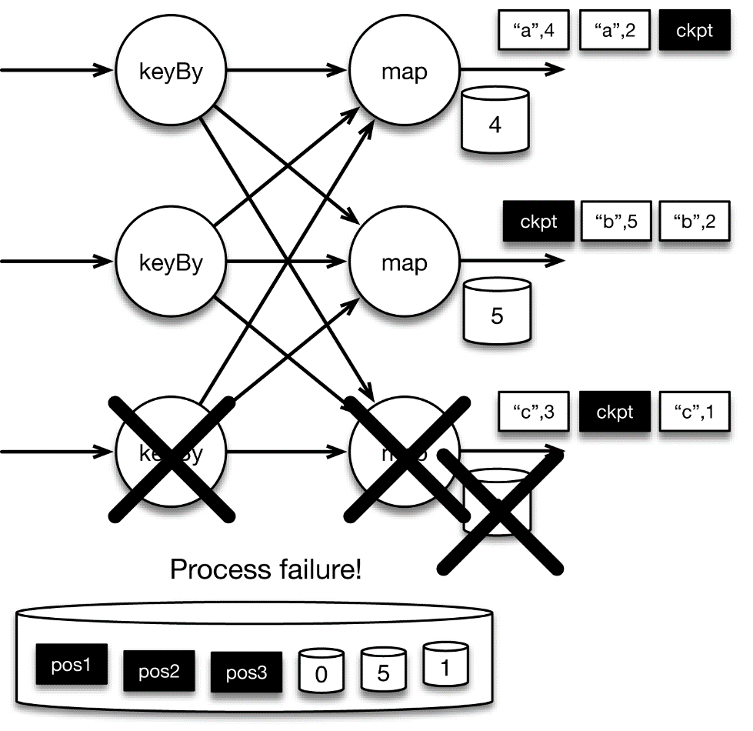
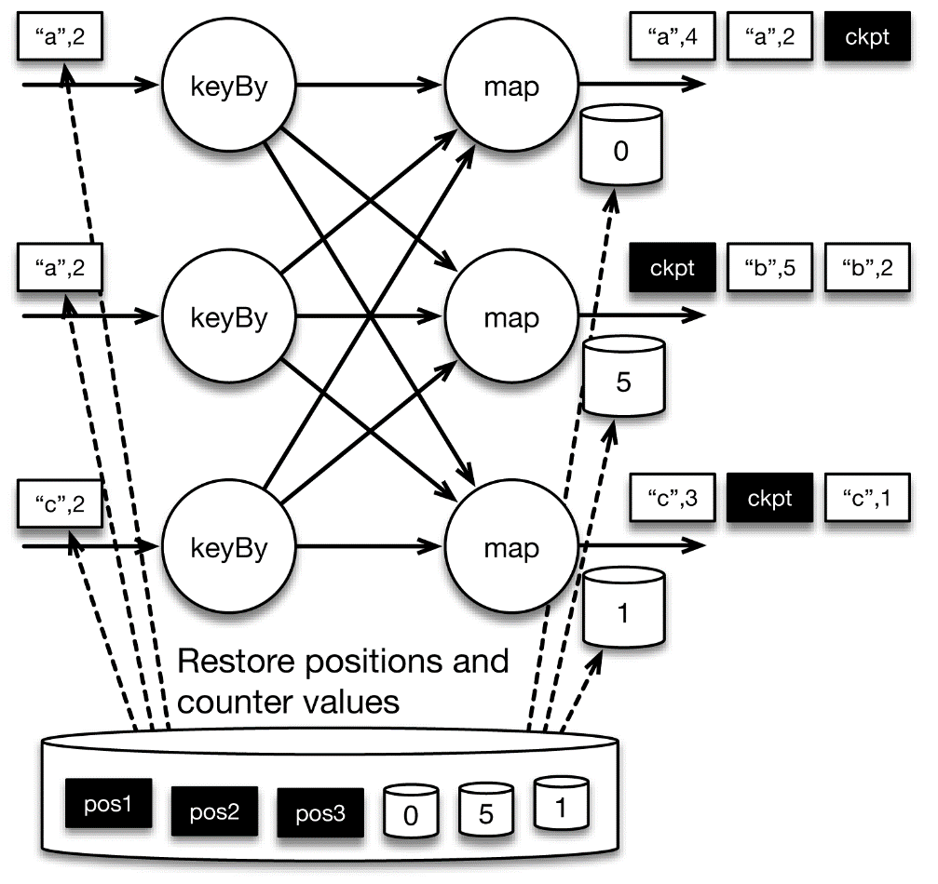
Consistency in Flink (5/5)
Checkpointing Step

Slide 39
Flink Operation
Flink Operation
Accurate computation
Windows
Event-time streaming
Watermarks
Exactly-Once Streaming Fault-Tolerance
Stateful streaming
Consistency in Flink
Manageability & Monitoring
Savepoints
Back Pressure

Slide 40
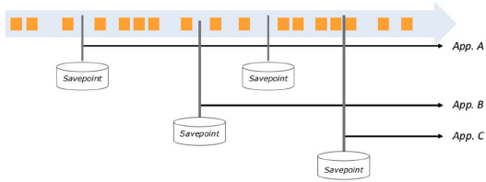
Savepoints
Savepoints
與checkpoints相同方法但由使用者驅動
透過Flink command line
建立snapshot，讓程式重啟但不丟失原本狀態
用途
程式升版/AB測試/伺服器停機、搬遷
可建立多組快照管理不同版本的state

Slide 41
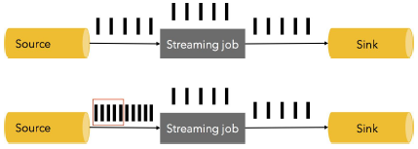
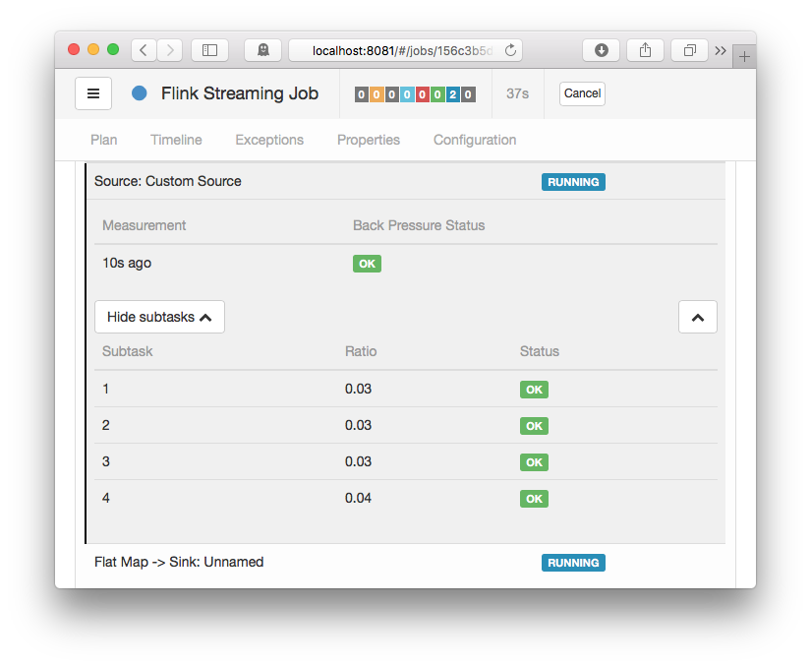
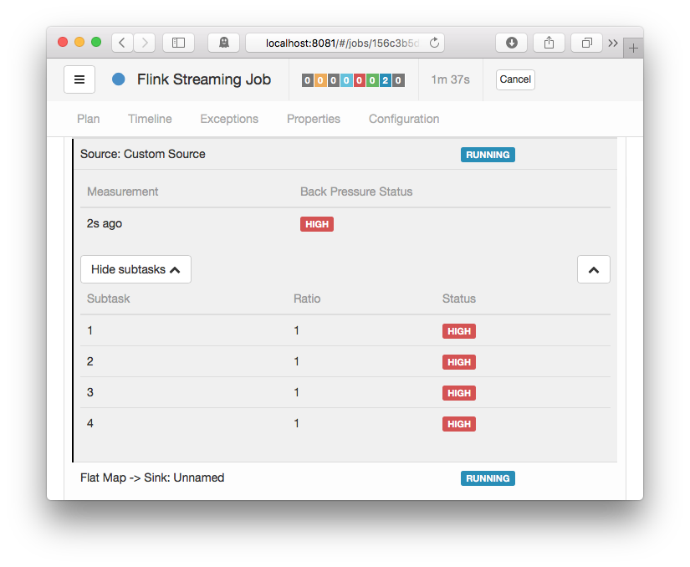
Monitoring Back Pressure
Back Pressure
流速不對等造成
上游(資料產生)的流速高於中游(運算)
中游(運算)流速高於下游(儲存)
資料由上游向下游流動， Back Pressure則以相反方向向前擴散

Slide 42
Apache Flink Development
Ethan Lin
ML8 CIM System Div
2017.02.14
Ethan_Lin@wistron.com

Slide 43
Agenda
Streaming Program Basic Structure
Stream Operation
Operation Overview
Data Sources
Time Characteristics
KeyedStream
Window Assigner
Window Functions
Use Case

Slide 44
Streaming Program Basic Structure

Slide 45
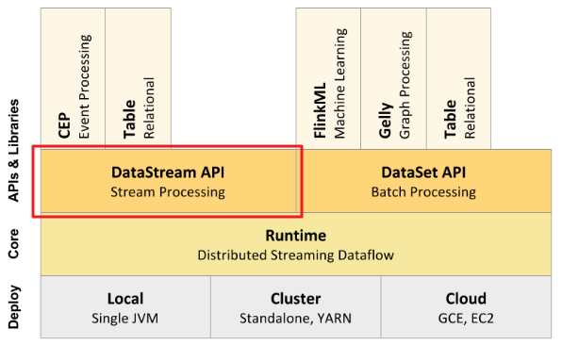
Basic Structure (1/4)
Flink模組 - DataStream

Slide 46
Basic Structure (2/4)
Flink DataStream程式
獲取執行環境
StreamExecutionEnvironment.getExecutionEnvironment()
讀取資料來源
檔案
Socket
Flink source connectors (Kafka, RabbitMQ…)
轉換
基本轉換: Map, Reduce, Filter, Aggregations…
二進位串流轉換: CoMap, CoReduce…
Windows: Time, Count, Delta…
多串流操作: Joins, Crosses…
迭代

Slide 47
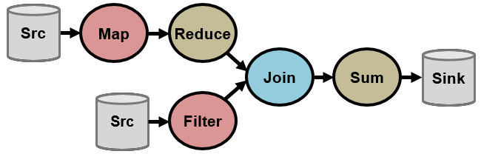
Basic Structure (3/4)
Flink DataStream程式
輸出
stdout (print)
檔案
Flink sink connectors (elasticsearch, Kafka)
觸發程式執行

Slide 48
Basic Structure (4/4)
Basic Structure
Flink同時支援串流計算與批量計算，僅需極少改動就能將batch程式改寫為Streaming程式
Batch僅是一種特殊的Streaming(有範圍的Streaming)
Connectors
Kafka
Cassandra
Kinesis
Elasticsearch
Rolling File Sink (HDFS)
RabbitMQ
NiFi
Twitter

Slide 49
Stream Operation

Slide 50
Stream Operation
Stream Operation
Operation Overview
Data Sources
Time Characteristics
KeyedStream
Window Assigner
Window Functions

Slide 51
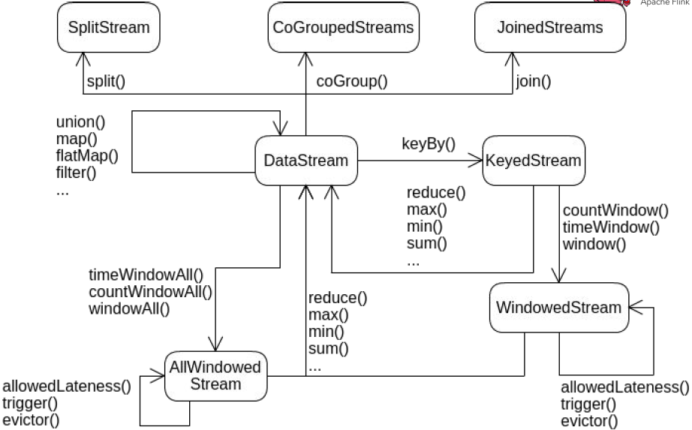
Operation Overview

Slide 52
Data Sources
// read text socket from port
DataStream<String> socketLines = env.socketTextStream("localhost", 9999);
// read a text file ingesting new elements every 100 milliseconds
DataStream<String> localLines =
env.readFileStream("/path/to/file", 100, WatchType.PROCESS_ONLY_APPENDED);
// read data stream from custom source function
DataStream<<Tuple2<Long, String> stream = env.addSource(new MySourceFunction());
// read data from many stream serving systems such as Apache Kafka
Properties properties = new Properties();
properties.setProperty("bootstrap.servers", "localhost:9092");
properties.setProperty("group.id", "testGroup");
DataStream<String> stream = env
.addSource(new FlinkKafkaConsumer09<>("topic", new SimpleStringSchema(), properties))

Slide 53
Time Characteristics
Time Characteristics
ExecutionEnvironment.setStreamTimeCharacteristic(TimeCharacteristic.ProcessingTime)

Slide 54
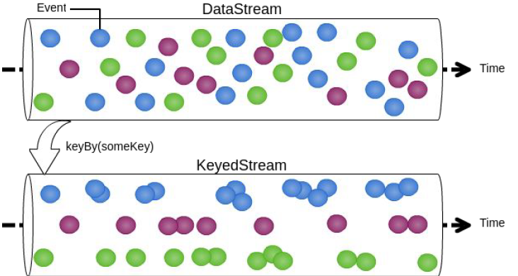
KeyedStream
KeyedStream
根據key將DataStream拆分
拆分後的KeyedStream可交由不同的worker node平行化運算
拆分後才能使用Key-Partitioned State

Slide 55
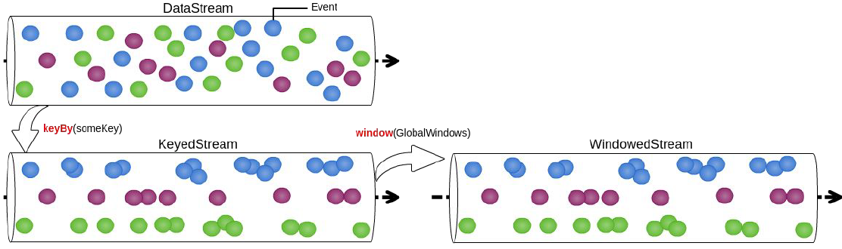
Window Assigner (1/5)
Window Assigner - Global Windows
沒有界限的Window
需自行定義trigger

Slide 56
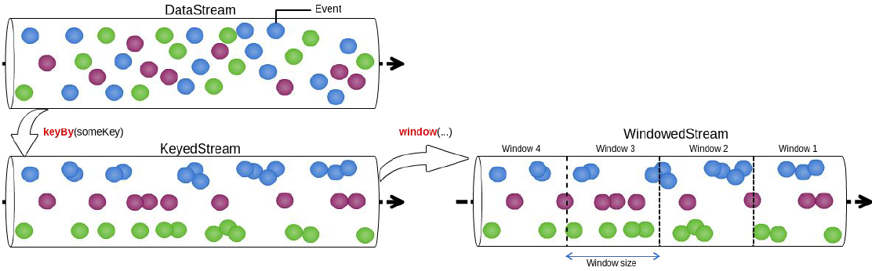
Window Assigner (2/5)
Window Assigner – Tumbling Time Windows
定義Window大小
元素不重覆
使用TumblingEventTimeWindows / TumblingProcessingTimeWindows

Slide 57
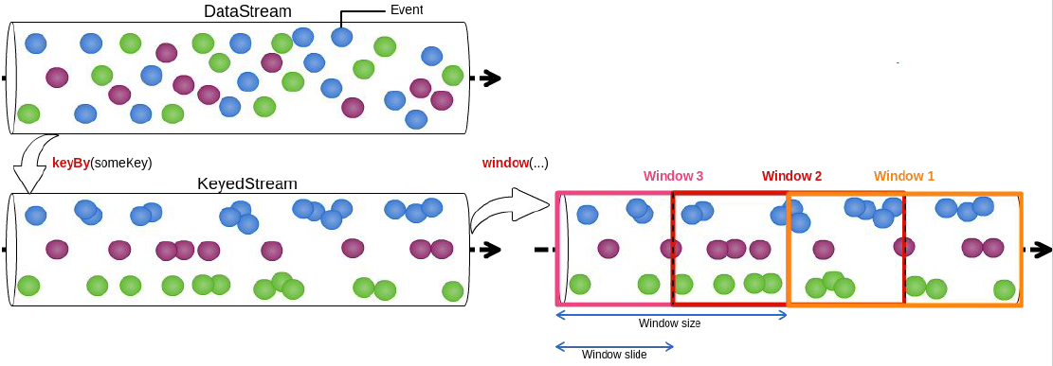
Window Assigner (3/5)
Window Assigner – Sliding Time Windows
定義Window大小及滑動的距離
元素可能重覆
使用SlidingEventTimeWindows / SlidingProcessingTimeWindows

Slide 58
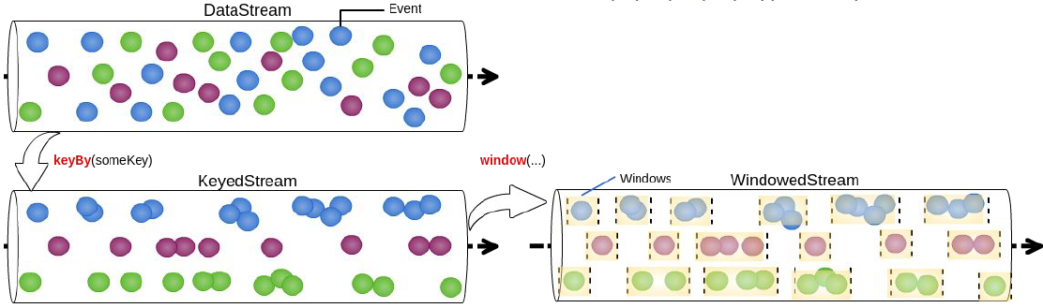
Window Assigner (4/5)
Window Assigner - Session Windows
定義gap
使用EventTimeSessionWindows / ProcessingTimeSessionWindows

Slide 59
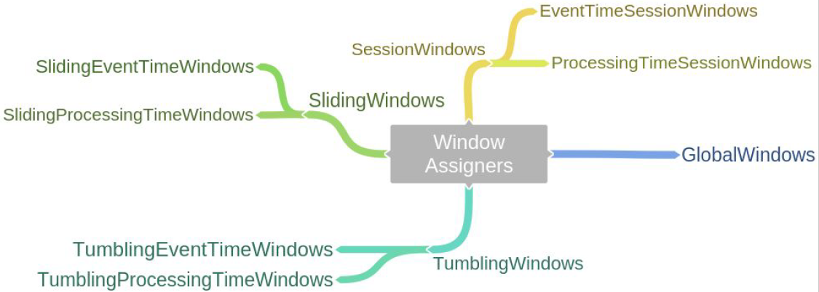
Window Assigner (5/5)
Cheat Sheet of Window Assigners

Slide 60
Window Functions (1/2)
ReduceFunction
遞增性的聚合
合併當前元素與上一個被 Reduce 的值，然後輸出新的值 (三者的類型需一致)
[1, 2, 3, 4, 5] -> reduce() means: ((((1 + 2) + 3) + 4) + 5) = 15
沒有window的meta data
FoldFunction
遞增性的聚合
基於初始值合併當前元素和上一個被Fold的值，然後輸出新值 (輸入值與返回值類型可以不一致)
[1, 2, 3, 4, 5] -> fold("start-") means: ((((("start-" + 1) + 2) + 3) + 4)
沒有window的meta data
無法使用在session windows

Slide 61
Window Functions (2/2)
WindowFunction
透過迭代器巡訪window中所有元素(效率較差)
暫存所有的元素
自行定義apply function操作每一個元素
提供window的meta data(如: start time, end time…)
WindowFunction with ReduceFunction / FoldFunction
遞增性的聚合
提供window的meta data

Slide 62
Use Case

Slide 63

Use Case
Live Demo

Slide 64
Apache Flink Tutorial The End, Thanks!
Ethan Lin
ML8 CIM System Div
2015.02.24
Ethan_Lin@wistron.com

Slide 65
Appendix

Slide 66
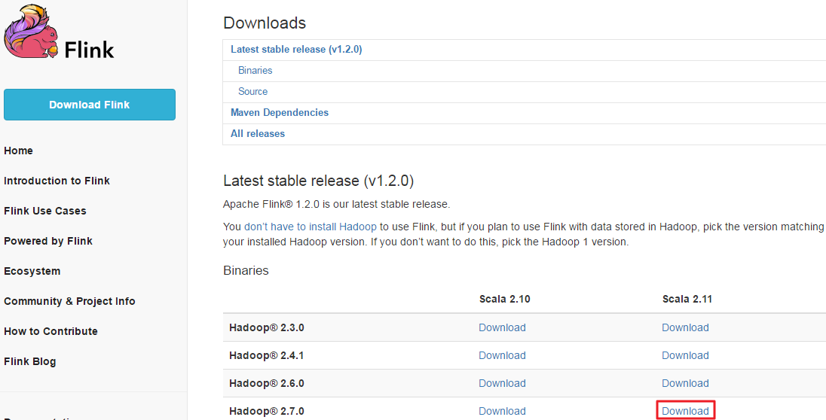
Flink Client Installation
Flink的官方下載網址是 https://flink.apache.org/downloads.html

Slide 67
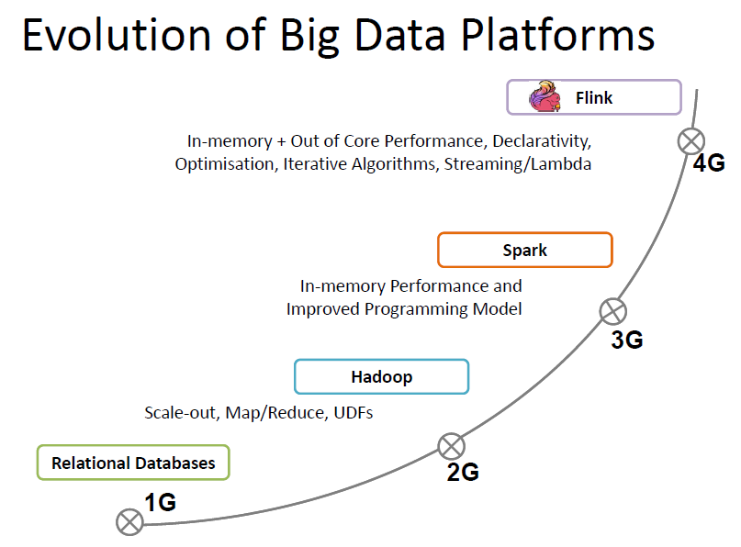
Evolution of Big Data Platforms
Platforms Evolution

Slide 68
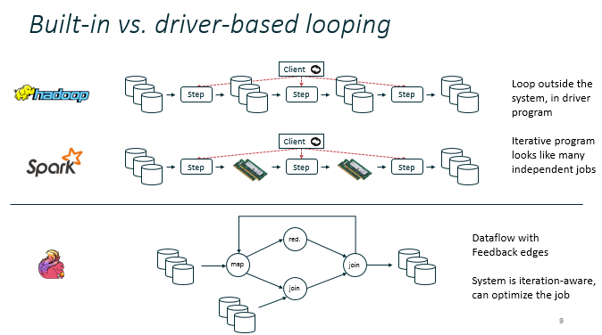
Evolution of Big Data Platforms
Platforms Evolution

Slide 69
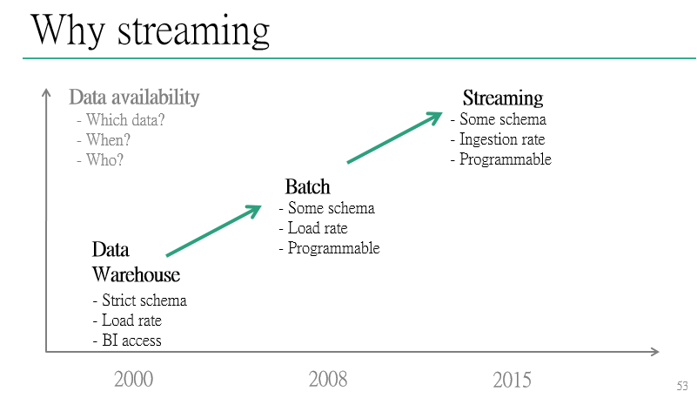
Why Streaming
Streaming Computation

